Slide 1
Growth Mindset day 1
Room 123

Slide 2
Objective: Students will be able to visualize their way of thinking, and relate it to math through pictures.
HLQ (Higher Level Questions): How is finding patterns within a picture applicable to your day to day learning in a math classroom?
Note: There are some HLQs mixed into the lesson that will represent a typical HLQ, but with today being the first day – I wanted you to get comfortable with the concept – you will see these everyday.

Slide 3

Find as many ways as you can to group the following dots.

Slide 4
Thinking about math differently…
How would you describe a circle to someone who doesn’t know about shapes?

Slide 5
Video
https://bhi61nm2cr3mkdgk1dtaov18-wpengine.netdna-ssl.com/wp-content/uploads/2017/06/Day-1-Mindset-8.mp4

Slide 6
Four 4’s Activity
Groups of 3 – 4
Create a list from 1–20 in which you use four 4s and any math operation
We’ll begin to fill out the chart on the next slide in 10 – 12 minutes

Slide 7
1 11
2 12
3 13
4 14
5 15
6 16
7 17
8 18
9 19
10 20

Slide 8
HLQs:
Can you use Four 4’s to make negative numbers? How or why not?
How many number’s can you create using Five 5’s?
What was special about the 4s?

Slide 9
Reflection (10 - 12 minutes) (write a few down on your board)
What things do you like people to say and/or do when you are working on a math problem in a group?
What things do you not like people to say and/or do when you are working on a math problem in a group?

Slide 10
Video
https://bhi61nm2cr3mkdgk1dtaov18-wpengine.netdna-ssl.com/wp-content/uploads/2017/07/Day-2-Brain-Crossing.mp4

Slide 11
Continue the following Pattern…
1.) Describe what you notice about the pattern
2.) Use your description to expand the pattern beyond the first 35 numbers (lets shoot for 50).
3.) Let’s talk about the process of recognizing the pattern, and compare it to applying it to your expanded pattern.
4.) What did you notice about even numbers? Multiples of 3? 4? 5? What did you notice about prime numbers?

Slide 13
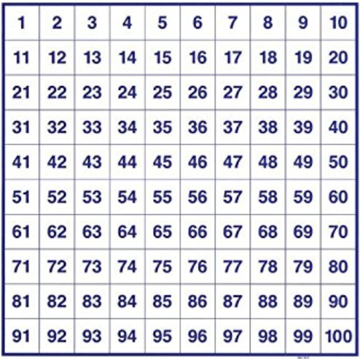

Slide 14
Exit Ticket
What do you want me to know about you in order to make this year the best year you’ve had in a math classroom?
Go back to the patterns you created. Explain what you see happening with perfect squares.

Slide 15
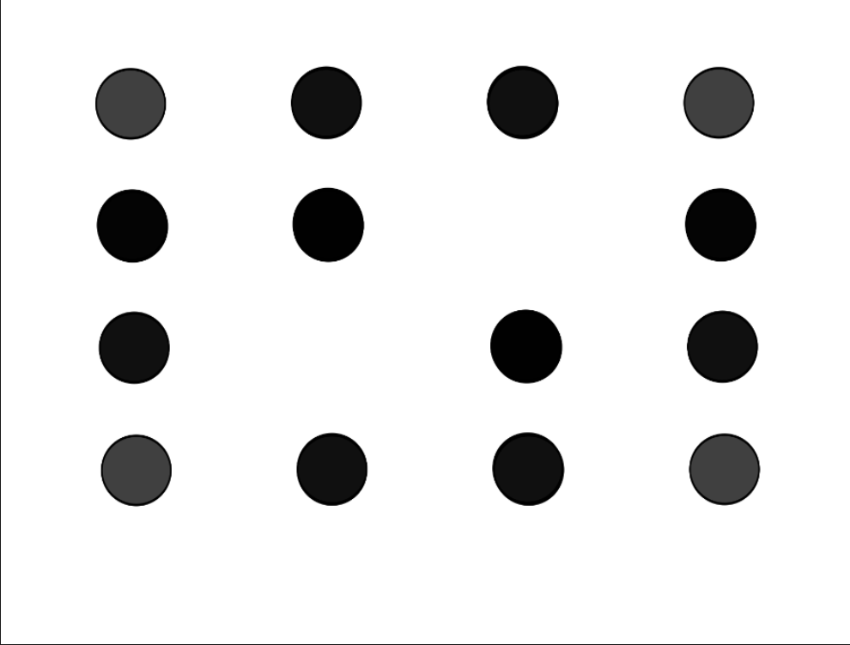
Additional Dot Problem.

